Slide 1

Topic for the class: Introduction to soft computing Unit &Title: I & soft computing
Mrs. M. Vijaya Bharathi
Assistant Professor
Department of Computer science Engineering
GITAM Institute of Technology (GIT)
Visakhapatnam – 530045
Email: vmanjeti@gitam.edu

Slide 2

Prerequisites
To extract the maximum from the course, the following prerequisites are must.
A strong mathematical background.
Proficiency with algorithms.
Programming skills in C, C++, or Java, MATLAB, etc.
Critical thinking and problem solving skills.

Slide 3
UNIT 1:
Introduction to Soft Computing and Neural Networks: Evolution of Computing: Soft Computing Constituents, From Conventional AI to Computational Intelligence: Machine Learning Basics
Learning outcomes:
After completion of this Unit the student will be able to
define soft computing and neural network
illustrate the evolution of the field of soft computing
explain the basics of machine learning L2

Slide 4
UNIT-1 syllabus
1)Introduction to Soft Computing and Neural Networks:
Evolution of Computing: Soft Computing Constituents
2)From Conventional AI to Computational Intelligence:
Machine Learning Basics

Slide 5
Need and Importance of the Course
Soft Computing is the study of science of reasoning, thinking, analyzing and detecting that correlates the real world problems to the biological inspired methods.
Soft Computing is the big motivation behind the idea of conceptual intelligence in machines.
It provides Optimal Solutions to the Problems

Slide 6
Concept Of Computing
Y=F(X) ,F is a mapping Function, Formal Method, Algorithm to solve the Function.
Procedure/Algorithm
Y=F(X)
Input
Antecedent
Output
Consequent

Slide 7
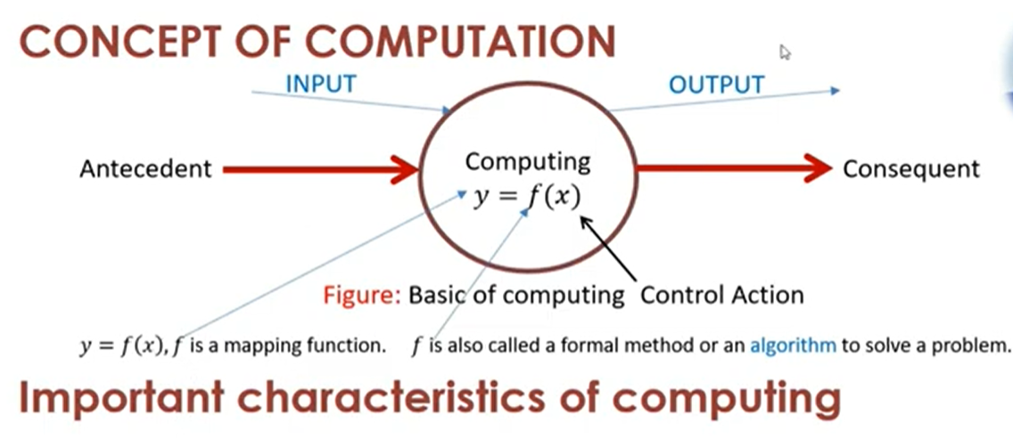

Slide 8
Concept Of Computing
.
COMPUTING
Hard Computing
Soft Computing

Slide 9
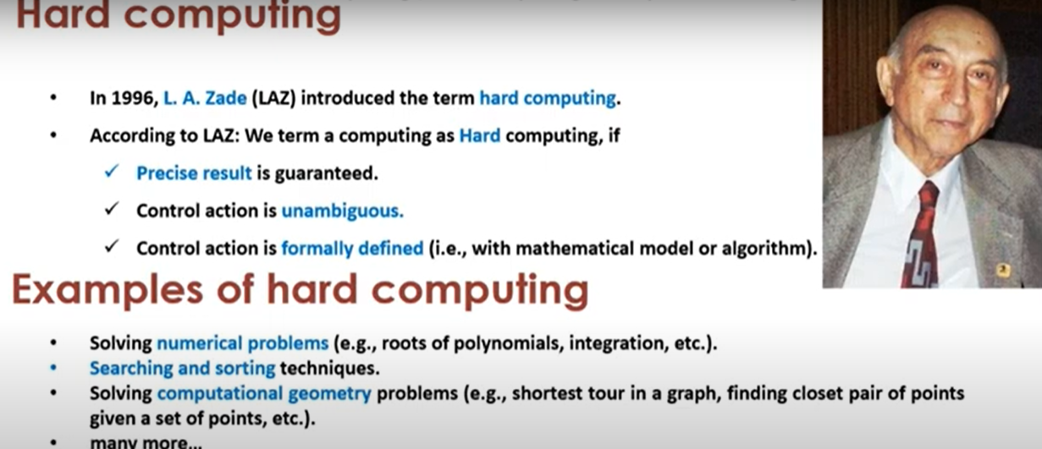

Slide 10
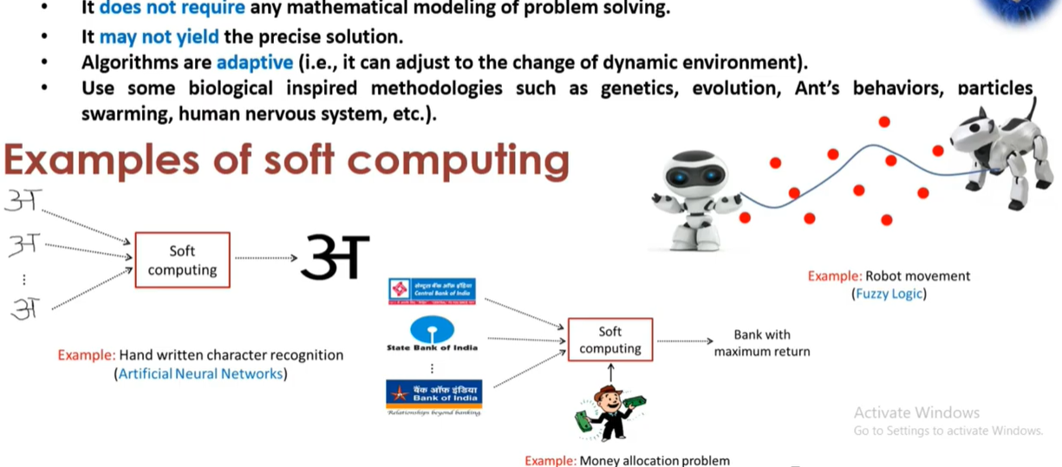
Characteristics of soft computing

Slide 11
Introduction to Soft Computing
What is Soft Computing ?
The idea of soft computing was initiated in 1981 when Lotfi A. Zadeh published his first paper on soft data analysis “What is Soft Computing”, Soft Computing. Springer-Verlag Germany/USA 1997.
Zadeh, defined Soft Computing into one multidisciplinary system as the fusion of the fields of Fuzzy Logic, Neuro-Computing, Evolutionary and Genetic Computing, and Probabilistic Computing.
Soft Computing is the fusion of methodologies designed to model and enable solutions to real world problems, which are not modeled or too difficult to model mathematically.
The aim of Soft Computing is to exploit the tolerance for imprecision, uncertainty, approximate reasoning, and partial truth in order to achieve close resemblance with human like decision making.

Slide 12
Goals of Soft Computing
Soft Computing is a new multidisciplinary field, to construct new generation of Artificial Intelligence, known as Computational Intelligence
The main goal of Soft Computing is to develop intelligent machines to provide solutions to real world problems, which are not modeled, or too difficult to model mathematically. Its aim is to exploit the tolerance for
Approximation : : here the model features are similar to the real ones, but not the same.
Uncertainty :: here we are not sure that the features of the model are the same as that of the entity (belief).
Imprecision , and Partial Truth in order to achieve close resemblance with human like decision making. Here the model features (quantities) are not the same as that of the real ones, but close to them.

Slide 13
Importance of Soft Computing
Soft computing differs from hard (conventional) computing. Unlike hard computing, the soft computing is tolerant of imprecision, uncertainty, partial truth, and approximation
The guiding principle of soft computing is to exploit these tolerance to achieve tractability, robustness and low solution cost. In effect, the role model for soft computing is the human mind.
The four fields that constitute Soft Computing (SC) are :
Fuzzy Computing (FC),
Evolutionary Computing (EC ),
Neural computing ( NC ), and
Probabilistic Computing (PC )

Slide 14
Importance of Soft Computing (cont..)
Soft computing is not a concoction, mixture, or combination, rather, Soft computing is a FUSION OF METHODOLOGIES THAT WORK SYNERGISTICALLY in one form or another , where each partner contributes a distinct methodology for addressing problems in its domain.
In principal the constituent methodologies in Soft computing are complementary rather than competitive.
Soft computing may be viewed as a foundation component for the emerging field of Conceptual Intelligence
“ROLE MODEL OF SOFT COMPUTING IS THE HUMAN MIND.”

Slide 15
Properties of Soft Computing methods
These methods have in common: They
1. are non linear.
2. have ability to deal with non linearity.
3. follow more human like reasoning paths than classical methods.
4. utilize self learning.
5. utilize yet-to-be proven theorems.
6. are robust in the presence of noise or errors.

Slide 16
Why Soft Computing approach ?
Mathematical model & analysis can be done for relatively simple systems.
More complex systems arising in biology, medicine & management systems remain intractable to conventional mathematical & analytical methods.
Typically human can:
Take decisions
Derive inference from previous situations experienced.
Expertise in an area.
Adapt to changing environment
Learn to do better
Social behavior of collective intelligence.
1 & 2 : Fuzzy Logic 3 & 4 : Neural Network 5 & 6 : Evolutionary Algorithms

Slide 17
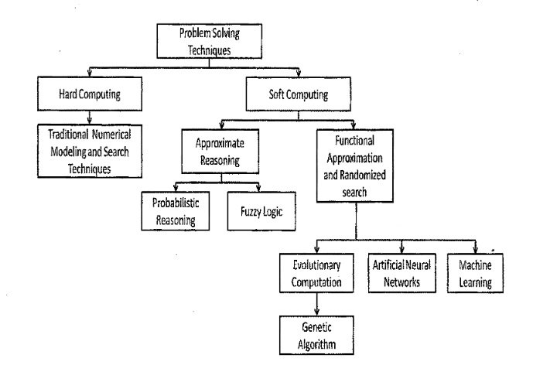
Various problem solving techniques

Slide 18
Soft computing techniques / tools / methods
Artificial Neural network
ANN is a parallel distributed information processing structure consisting of a number of nonlinear processing units called neurons.
The neuron operates as a mathematical processor performing specific mathematical operations on its inputs to generate an output.
It can be trained to recognize patterns and to identify incomplete patterns by resembling the human-brain processes of recognizing information, burying noise literally and retrieving information correctly.
ANN are strongly interconnected systems of neurons which have simple behavior, but when connected they can solve complex problems. Changes may be made further to enhance its performance

Slide 19
Soft computing techniques / tools / methods
2. Genetic algorithms
Evolutionary algorithms (EA) were invented to mimic some of the processes observed in natural evolution. Evolution occurs on chromosomes - organic devices for encoding the structure of living beings.
Processes of natural selection then drive those chromosomes that encode successful structures to reproduce more frequent than those that encode failed structures. In other word, the chromosomes with the best evaluations tend to reproduce more often than those with bad evaluations.
By using simple encodings and reproduction mechanisms, the algorithms can then display complicated behavior and turn out to solve some extremely difficult problems.
Based on the principles of natural evolution, GAs are robust and adaptive methods to solve search and optimization problems.
In addition, by simulating some features of biological evolution, GA can solve problems where traditional search and optimization methods are less effective.

Slide 20
Soft computing techniques / tools / methods
3. Fuzzy Logic
In the real world, information is often ambiguous or imprecise.
When we state that it is warm today, the context is necessary to approximate the temperature.
A warm day in January may be degrees Celsius, but a warm day in August may be 33 degrees. After a long spell of frigid days, we may call a milder but still chilly day relatively warm.
Human reasoning filters and interprets information in order to arrive at conclusions or to dismiss it as inconclusive.
Although machines cannot yet handle imprecise information in the same ways that humans do, computer programs with fuzzy logic are becoming quite useful when the sheer volume of tasks defines human analysis and action.
An organized method for dealing with imprecise data is called fuzzy logic. The data sets engaged in fuzzy logic are considered as fuzzy sets.

Slide 21
Soft computing techniques / tools / methods
Contd..
Traditional sets include or do not include an individual element; there is no other case than true or false. Fuzzy sets allow partial membership.
Fuzzy Logic is basically a multi-valued logic that allows intermediate values to be defined between conventional evaluations like yes/no, true/false, black/white, etc.
Notions like rather warm or pretty cold can be formulated mathematically and processed with the computer.
In this way, an attempt is made to apply a more humanlike way of thinking in the programming of computers.
Fuzzy logic is an extension of the classical propositional and predicate logic that rests on the principles of the binary truth functionality.

Slide 22
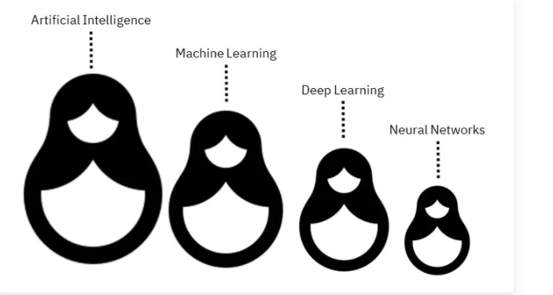

Slide 23
Machine learning :A subset of artificial intelligence involved with the creation of algorithms which can modify itself without human intervention to produce desired output- by feeding itself through structured data.
Deep learning: A subset of machine learning where algorithms are created and function similar to those in machine learning, but there are numerous layers of these algorithms- each providing a different interpretation to the data it feeds on. Such a network of algorithms are called artificial neural networks.
Neural networks :an attempt at imitating the function of the human neural networks present in the brain.

Slide 24
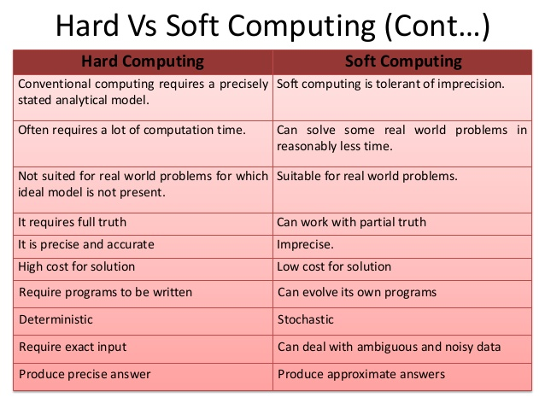
Hard Computing Vs Soft Computing

Slide 25
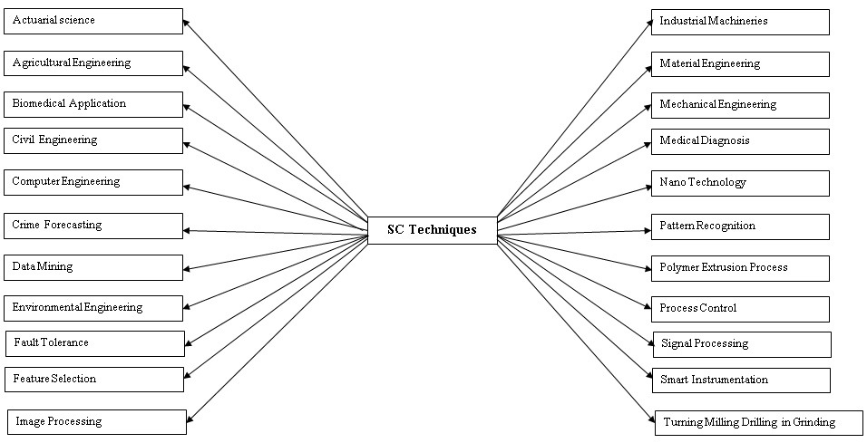
Application areas of soft computing

Slide 26

Soft computing is a field of computer science which makes use of inexact solutions for problems which has no known method to compute an exact solution
It uses imprecision, uncertainty, partial truth, and approximation as input.

Slide 27

Hard computing
Deals with precise values
Accurate output is needed
Useful in critical systems
Soft computing
Deals with assumptions
Accuracy is not necessary
Useful for routine,control, decison making tasks

Slide 28
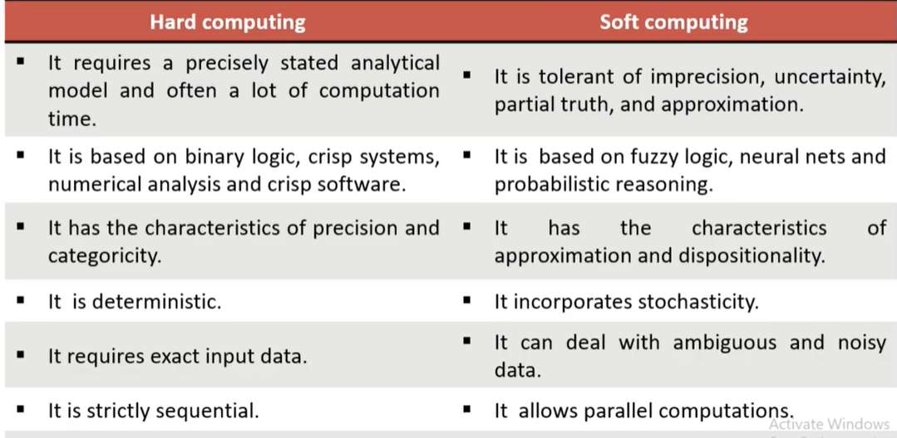

Slide 29
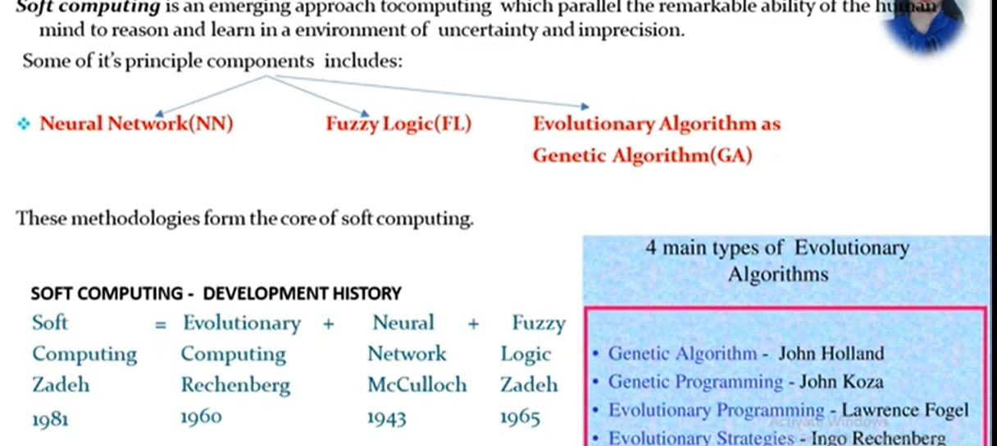

Slide 30
Soft Computing
Refers to a consortium of computational methodologies Some of its principle components include Fuzzy Logic, Neural Network, Genetic Algorithms all are having roots in AI
It is a collection of methodologies that aim to exploit the Tolerance for Imprecision and Uncertainty to achieve tractability robustness and Low solution cost its principle components include Fuzzy Logic, Neuro computing and probabilistic reasoning.

Slide 31
ARTIFICIAL INTELLIGENCE
If the intelligence is demonstrated by the human it is called as natural intelligence ,else if it is demonstrated by the machines it is called as artificial intelligence i.e automation of intelligence behavior.
Hard computing is conventional computing it requires precisely stated analytical model and often requires lot of computational time

Slide 32


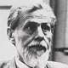
Founded in 1940
Artificial neural network mimics the biological neuron network in function
Warren S Mullcock

Slide 33

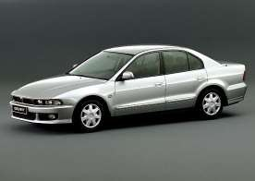

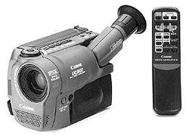
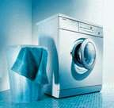

Heavy industry
Robotic arms, Humanoid robots
Home appliances
Washing machines, ACs, Refrigerators, cameras
Automobiles
Travel Speed Estimation, Sleep Warning Systems, Driver-less cars
Spacecrafts
Maneuvering of a Space Shuttle(FL), Optimization of Fuel- efficient Solutions for space craft

Slide 34
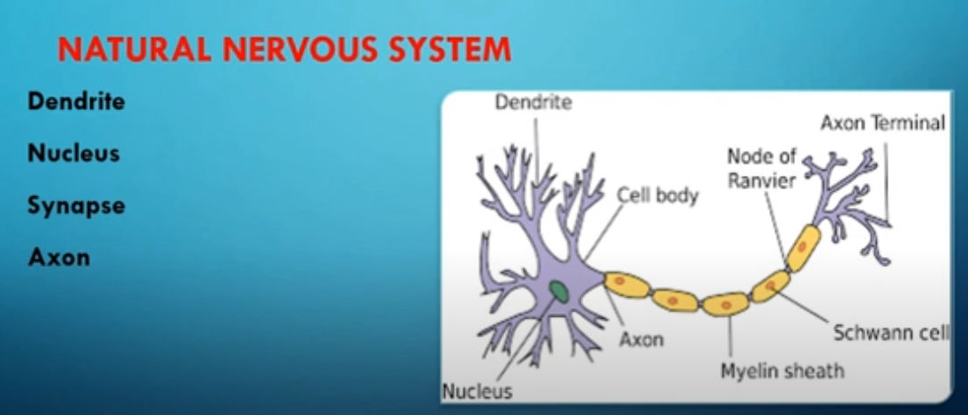
Dendrite : A bush of very thin fibre.
Axon : A long cylindrical fibre.
Soma : It is also called a cell body, and just like as a nucleus of cell.
Synapse : It is a junction where axon makes contact with the dendrites of neighboring dendrites

Slide 35


Slide 36
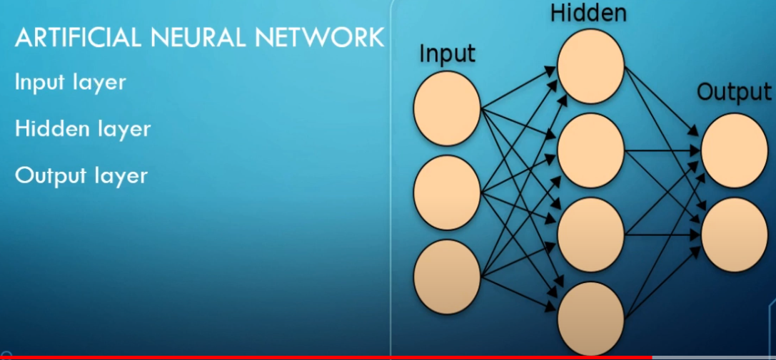

Slide 37
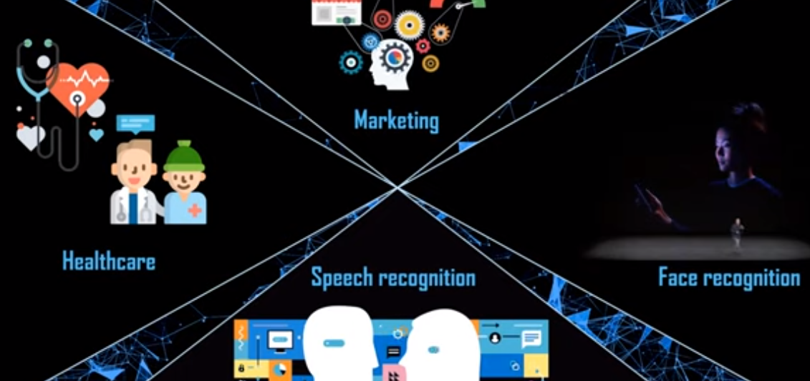

Slide 38
Biological nervous system
Biological nervous system is the most important part of many living things, in particular, human beings.
There is a part called brain at the center of human nervous system.
In fact, any biological nervous system consists of a large number of interconnected processing units called neurons.
Each neuron is approximately 10µm long and they can operate in parallel.
Typically, a human brain consists of approximately 10¹¹ neurons communicating with each other with the help of electrical impulses.
Soft Computing Applications
38 / 20

Slide 39
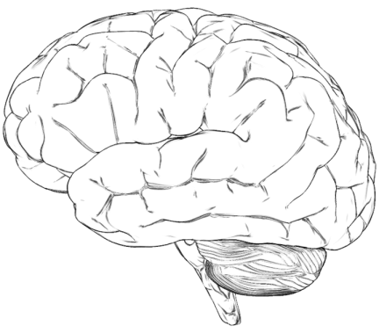
Brain: Center of the nervous system
Soft Computing Applications
39 / 20

Slide 40
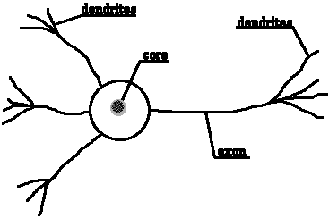
Dendrite of another neuron
Neuron: Basic unit of nervous system
Synapse
soma
Soft Computing Applications
40 / 20

Slide 41
Neuron and its working
Dendrite of another neuron
Synapse
soma
Figure shows a schematic of a biological neuron. There are different parts in it : dendrite, soma, axon and synapse.
Dendrite : A bush of very thin fibre.
Axon : A long cylindrical fibre.
Soma : It is also called a cell body, and just like as a nucleus of cell.
Synapse : It is a junction where axon makes contact with the dendrites of neighboring dendrites.
Soft Computing Applications
41 / 20

Slide 42
Neuron and its working
There is a chemical in each neuron called neurotransmitter.
A signal (also called sense) is transmitted across neurons by this chemical.
That is, all inputs from other neuron arrive to a neurons through dendrites.
These signals are accumulated at the synapse of the neuron and then serve as the output to be transmitted through the neuron.
An action may produce an electrical impulse, which usually lasts for about a millisecond.
Note that this pulse generated due to an incoming signal and all signal may not produce pulses in axon unless it crosses a threshold value.Also, note that an action signal in axon of a neuron is commutative signals arrive at dendrites which summed up at soma.
Soft Computing Applications

Slide 43
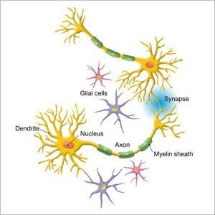
Neuron and its working
Soft Computing Applications

Slide 44
Artificial neural network
In fact, the human brain is a highly complex structure viewed as a massive, highly interconnected network of simple processing elements called neurons.
Artificial neural networks (ANNs) or simply we refer it as neural network (NNs), which are simplified models (i.e. imitations) of the biological nervous system, and obviously, therefore, have been motivated by the kind of computing performed by the human brain.
The behavior of a biolgical neural network can be captured by a simple model called Artificial neural network.
Soft Computing Applications

Slide 45
Neural networks
What is neural network?
Neural means neurons (From human brain)
network :sharing of data and information
Neural network: information processing paradigm inspired by biological nervous systems, such as our brain
Structure: large number of highly interconnected processing elements (neurons) working together
Like people, they learn from experience (by example)

Slide 46
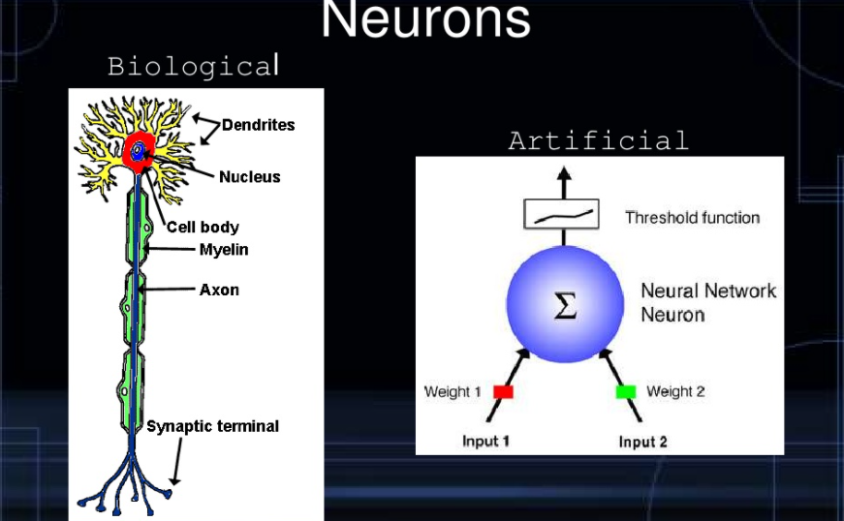

Slide 47
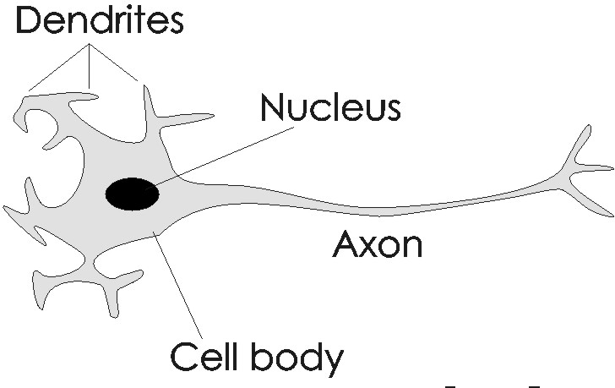

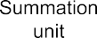
Analogy between BNN and ANN
x1
w1
x2
w2
w3
x3
wn
xn
Soft Computing Applications

Slide 48
Model Of A Neuron
W_{a}
X₁
μ
W_{b}
f(μ)
Y
X₂
W_{c}
X₃
Input units
Connection weights
Summing function
computation
(dendrite)
(synapse)
(axon)
(soma)

Slide 49

Artificial neural network
x1
w1
x2
w2
w3
x3
wn
xn
…..
input
weight
Summation unit
Threshold unit
output
Here, x₁, x₂, · · · , x_{n} are the n inputs to the artificial neuron.
w₁, w₂, · · · , w_{n} are weights attached to the input links.
Soft Computing Applications

Slide 50
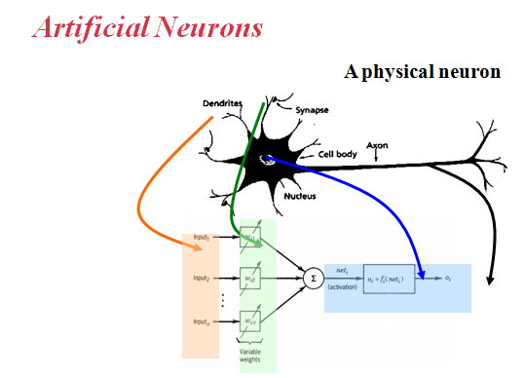

Slide 51
Artificial neural network
Note that, a biological neuron receives all inputs through the dendrites, sums them and produces an output if the sum is greater than a threshold value.
The input signals are passed on to the cell body through the synapse, which may accelerate or retard an arriving signal.
It is this acceleration of the input signals that is modeled by the weights.
An effective synapse, which transmits a stronger signal will have a correspondingly larger weights while a weak synapse will have smaller weights.
Thus, weights here are multiplicative factors of the inputs to account for the strength of the synapse.
Soft Computing Applications

Slide 52
Artificial neural network
Hence, the total input say I received by the soma of the artificial neuron is
Σ
I = w₁x₁ + w₂x₂ + · · · + w_{n}x_{n} =
n i =1
w_{i} x_{i}
To generate the final output y , the sum is passed to a filter φ
called transfer function, which releases the output.
That is, y = φ(I)
Ø(I)
x1
w1
x2
w2
I
y
w3
x3
wn
…..
xn
Summation unit
input
weight
Threshold unit
output
Soft Computing Applications

Slide 53
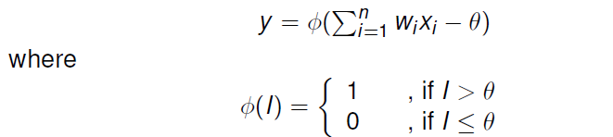
Artificial neural network
A very commonly known transfer function is the thresholding function.
In this thresholding function, sum (i.e. I) is compared with a threshold value θ.
If the value of I is greater than θ, then the output is 1 else it is 0 (this is just like a simple linear filter).
In other words,
Σ
y = φ(
n i =1
w_{i} x_{i} − θ)
1 , if I > θ
0 , if I ≤ θ
where
.
φ(I) =
Such a Φ is called step function (also known as Heaviside function).
Soft Computing Applications

Slide 54
Activation Functions
Identity f(x) = x
Binary step f(x) = 1 if x >= θ f(x) = 0 otherwise
Binary sigmoid f(x) = 1 / (1 + e^{-σx})
Bipolar sigmoid f(x) = -1 + 2 / (1 + e^{−σx})
Hyperbolic tangent f(x) = (e^{x} – e^{-x}) / (e^{x} + e^{-x})

Slide 55
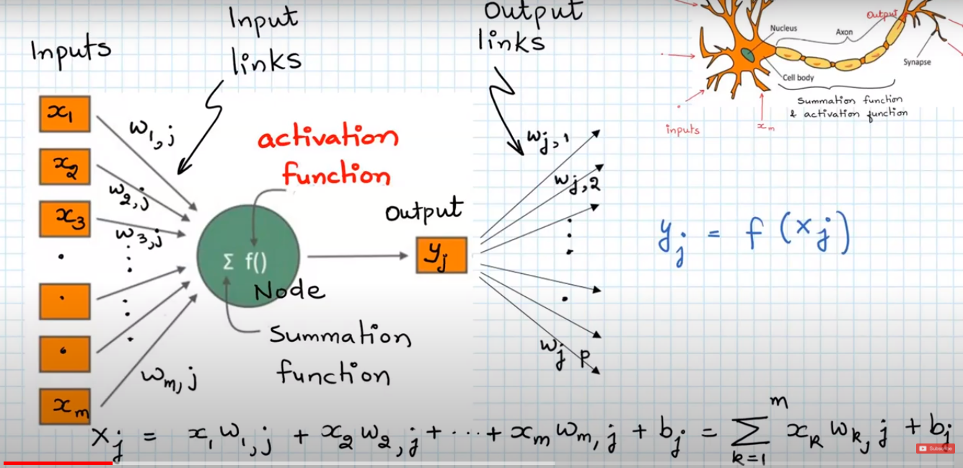

Slide 56
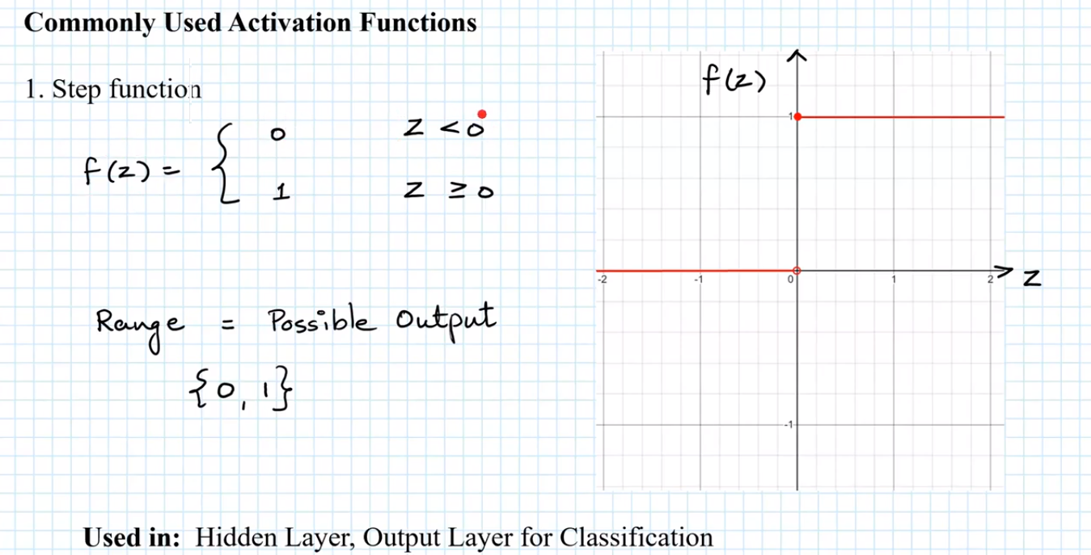

Slide 57
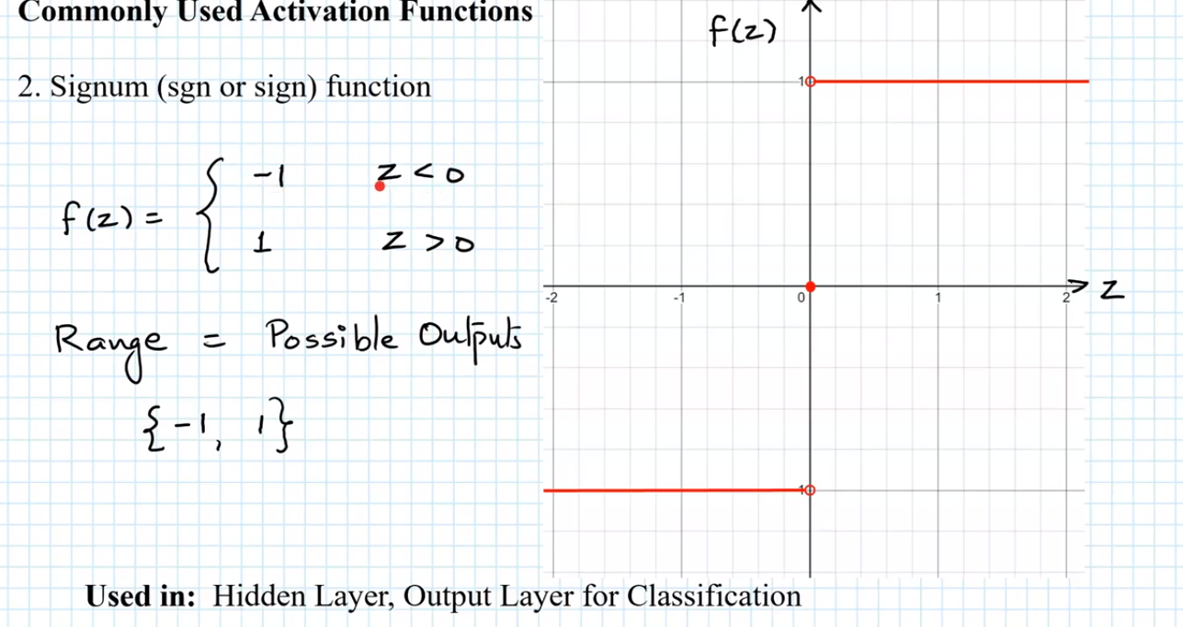

Slide 58
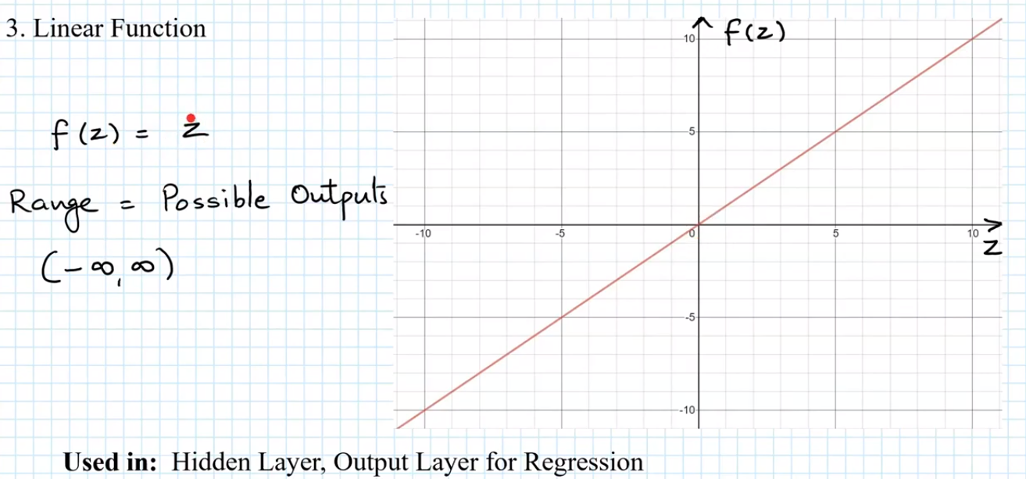

Slide 59
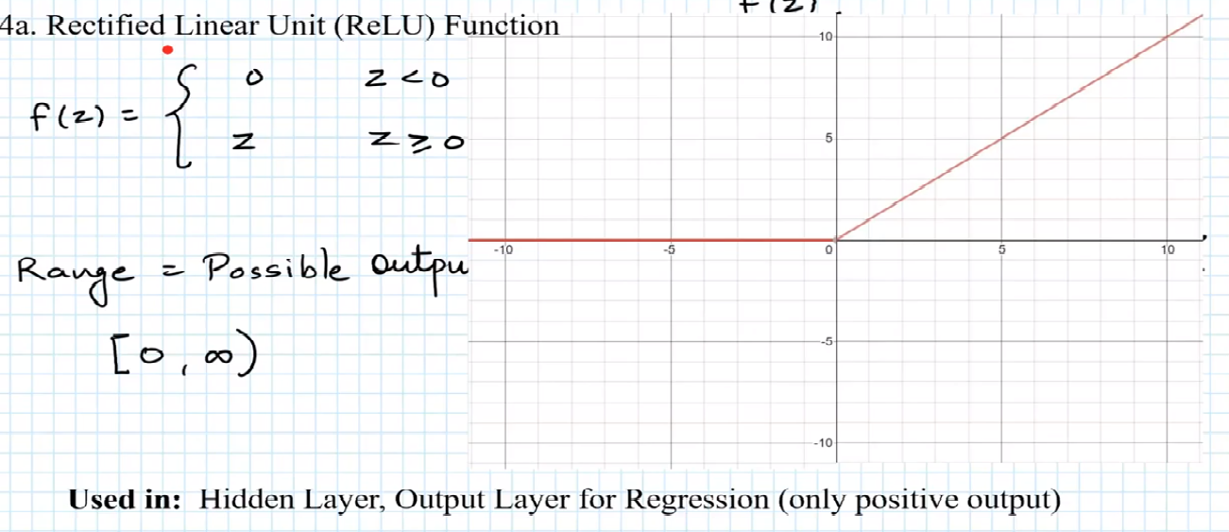

Slide 60
Exercise
2 input AND
2 input OR
1 | 1 | 1
1 | 0 | 0
0 | 1 | 0
0 | 0 | 0
1 | 1 | 1
1 | 0 | 1
0 | 1 | 1
0 | 0 | 0

Slide 61
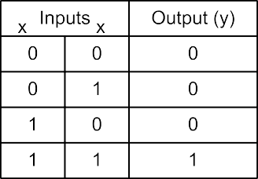
The AND problem and its neural network
A possible neuron specification to solve the AND problem is given in the following. In this solution, when the input is 11, the weight sum exceeds the threshold (θ = 0.9) leading to the output 1 else it gives the output 0.
1
2
1
2
Here, y = ∑w_{i} x_{i} − θ and w₁ = 0.5,w₂ = 0.5 and θ = 0.9
Soft Computing Applications

Slide 62
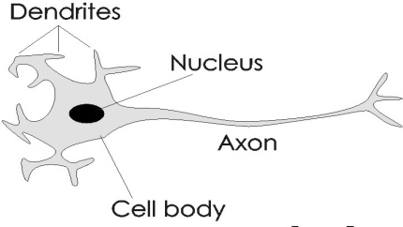
The AND problem and its neural network
Alternatively, the AND problem can be thought as a perception problem where we have to receive four different patterns as input and perceive the results as 0 or 1.
00
10
01
11
0
1
x₁
w1
Y
w2
x2
Soft Computing Applications

Slide 63
Advantages of ANN
ANNs exhibits mapping capabilities, that is, they can map input patterns to their associated output pattern.
The ANNs learn by examples.
The ANNs posses the capability to generalize
The ANNs are robust system and fault tolerant. They can therefore, recall full patterns from incomplete, partial or noisy patterns.
The ANNS can process information in parallel, at high speed and in a distributed manner
Soft Computing Applications

Slide 64
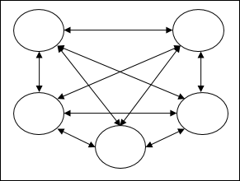
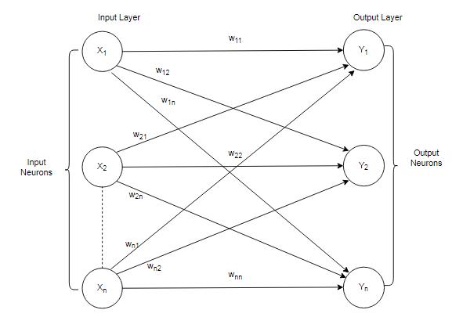
NN Architectures
NN structure can be represented using Directed Graph
it is ordered tuple (V,E) vertices and Edges( v1,v2..Vn),(e1,e2,….En)
Vertices of Graph represent neurons(I/O)
Edges represent Synaptic links
The edges are labeled by the weights and attached to synaptic Links

Slide 65
Contd..
Several Classes of NN, Classified according to learning Mechanisms.
Single Layer Feed Forward Network
Multi layer Feed Forward Network
Recurrent neural Network

Slide 66
Single Layer Feed Forward Network
This network comprises 2 layers
1.Input Layer 2.Out Put Layer
Input layer receives the Input signals and Out put layer receives the Out put Signals. The synaptic link connect every i/p neuron to o/p neuron. Hence it is Feed Forward.
The i/p layer transmits the signals to o/p layer.
The O/P layer performs computations , hence it is SLFFNN.

Slide 67
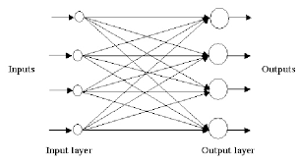
Single Layer Feed Forward Network

Slide 68
Multi layer Feed Forward Network
MLFFNN (L-m1-m2-n) configuration.
As name indicates N/W is made up of multi layers.
I/P,O/P, Hidden layers(M1,M2)
Computational units of hidden layer are called hidden neurons and hidden weights.
I/P- hidden layer weights
Hidden-O/P layer weights

Slide 69
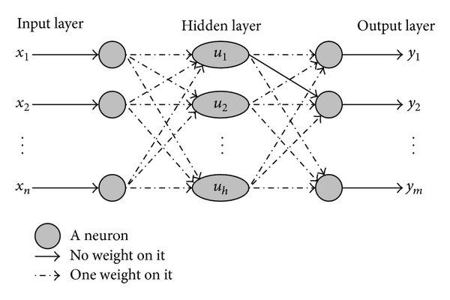
Multi layer Feed Forward Network

Slide 70
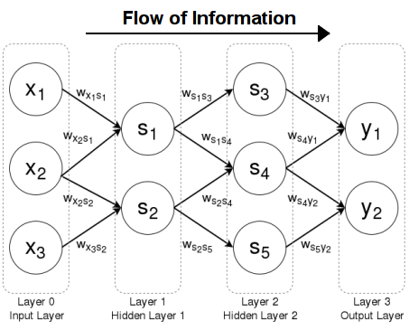
L-m1-m2-n MLFFNN

Slide 71
Recurrent NN
Differs from Single and Multi layer Architecture in the sence that there is a at least one feed back loop is there.
There exist one layer with feedback connections
Self feed back loops will be there
O/P of neuron is I/P to the other in the form of feedback.
There could also be neurons with self back lines ,that is output neuron is feedback into itself as a output.

Slide 72
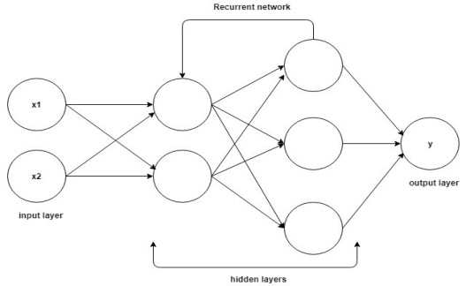

Slide 73
Characteristics of NN
NN exhibits mapping capabilities { mapping of I/P and O/P patterns}
NN learns by example
NN posses the capability to generalize, predict the new out comes from past trends
NN are Robust and Fault Tolerant systems
NN can process information in parallel at higher speed and distributed manner.

Slide 74
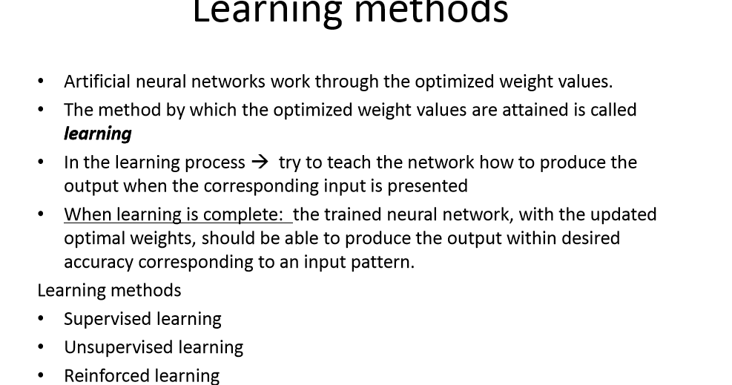

Slide 75
Learning is a process of which free parameter of the neural networks are adopted through a process of change in environment in which neural network is present.

Slide 76
NN learning Methods
1. Supervised Learning
a. Error Correction
a1.Least mean Square
a2.Back Propagation
b. Stochastic
2. Un Supervised Learning
a. Hebbian
b. Competitive
3. Reinforced learning.

Slide 77
Supervised Learning
Every I/P pattern is used to train the N/W associated with O/P pattern.
A teacher is assumed to be present during the learning process
Comparison is made b/n N/W computed O/P and the expected O/P to determine the error.
Error can be used to change N/W parameters which results in improvement of performance.

Slide 78
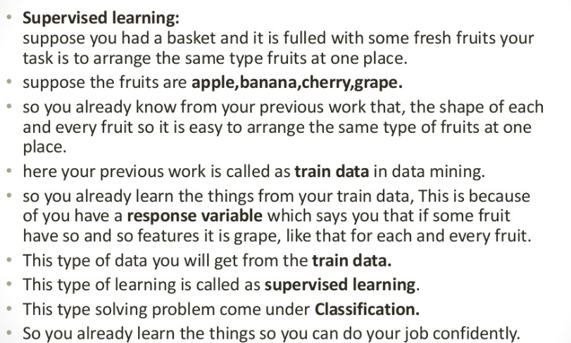

Slide 79
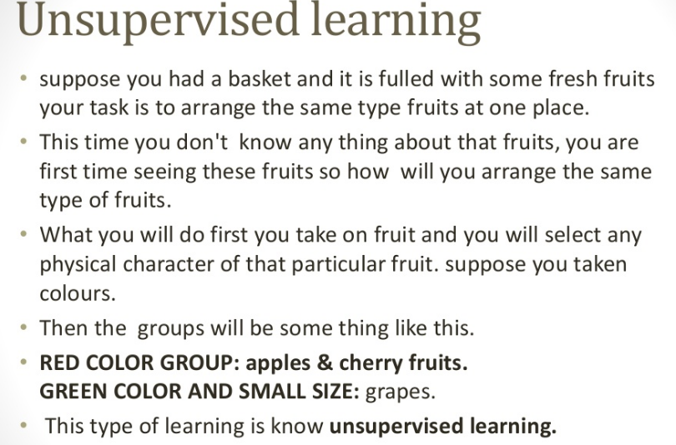

Slide 80


Types of Learning
Supervised: Learning with a labeled training set
Example: email classification with already labeled emails
Unsupervised: Discover patterns in unlabeled data
Example: cluster similar documents based on text
Reinforcement learning: learn to act based on feedback/reward
Example: learn to play Go, reward: win or lose
class A
class A
Classification
Clustering
Anomaly Detection
Sequence labeling
…

Slide 81
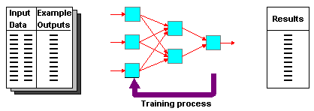
Supervised Learning
Training and test data sets
Training set; input & target

Slide 82
Training Perceptrons
For AND
A B Output
0 0 0
0 1 0
1 0 0
1 1 1
-1
W₁ = ?
x
t = 0.0
W₂ = ?
W₃ = ?
y
What are the weight values?
Initialize with random weight values

Slide 83
Training Perceptrons
For AND
A B Output
0 0 0
0 1 0
1 0 0
1 1 1
-1
W₁ = 0.3
x
t = 0.0
W₂ = 0.5
W₃ =-0.4
y

Slide 84
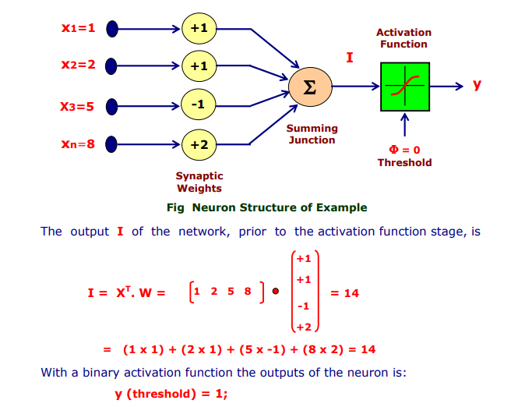

Slide 85
Stochastic Learning
Weights are adjusted in probabilistic fashion
Learning mechanism is employed by Boltzmann and Cauchy machines.

Slide 86
Hebbian Learning
Proposed by Hebb and is based on correlative weight adjustment
Oldest and inspired by biology
In this I/P-O/P patterns pairs (Xi,Yi) are associated by weight matrix W, Known as Correlation Matrix
It is compute as W= ∑X_{i}.Y_{i} ^{Т}.
Y_{i} ^{T} is the Transpose of the Y_{i}

Slide 87
What is Machine Learning?
Machine Learning
Study of algorithms that
improve their performance
at some task
with experience
Optimize a performance criterion using example data or past experience.
Role of Statistics: Inference from a sample
Role of Computer science: Efficient algorithms to
Solve the optimization problem
Representing and evaluating the model for inference

Slide 88
Growth of Machine Learning
Machine learning is preferred approach to
Speech recognition, Natural language processing
Computer vision
Medical outcomes analysis
Robot control
Computational biology
This trend is accelerating
Improved machine learning algorithms
Improved data capture, networking, faster computers
Software too complex to write by hand
New sensors / IO devices
Demand for self-customization to user, environment
It turns out to be difficult to extract knowledge from human experts→failure of expert systems in the 1980’s.

Slide 89
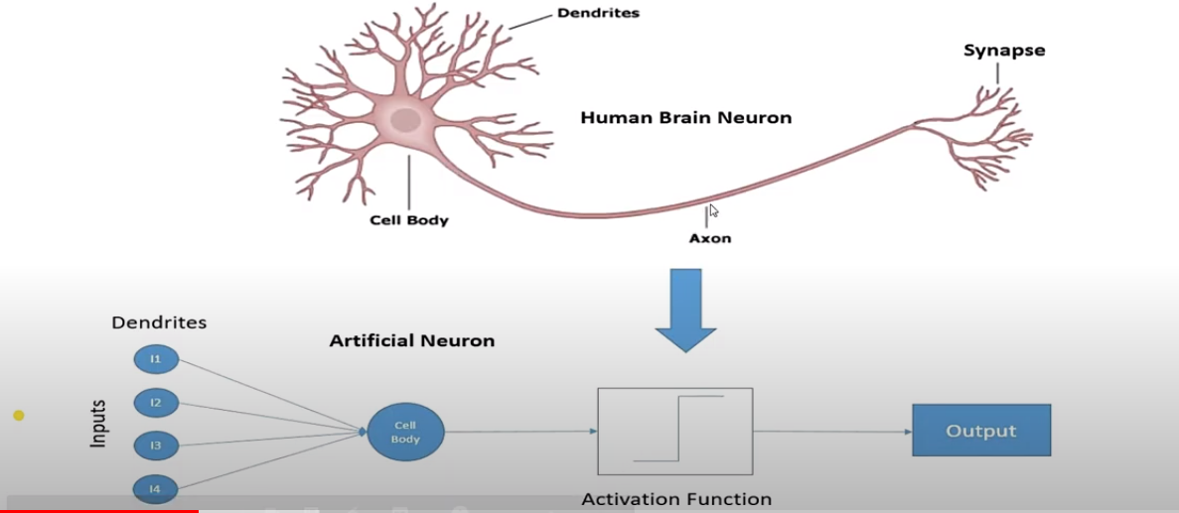
Machine learning basics

Slide 90
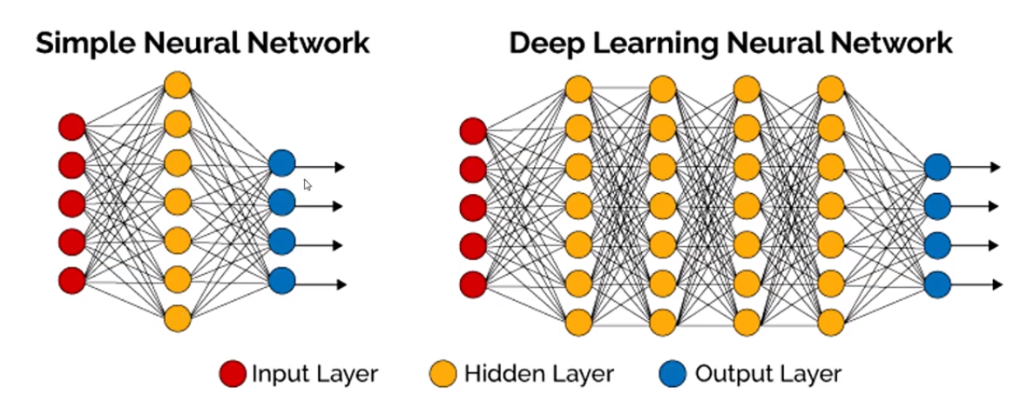

Slide 91
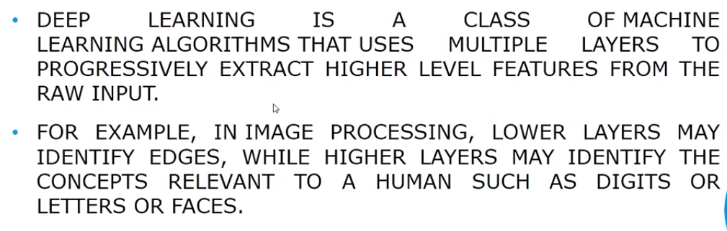

Slide 92
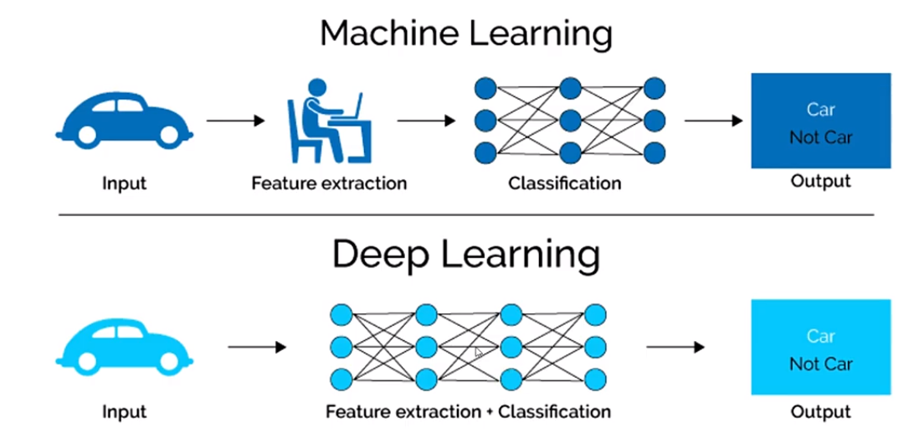

Slide 93


Slide 94
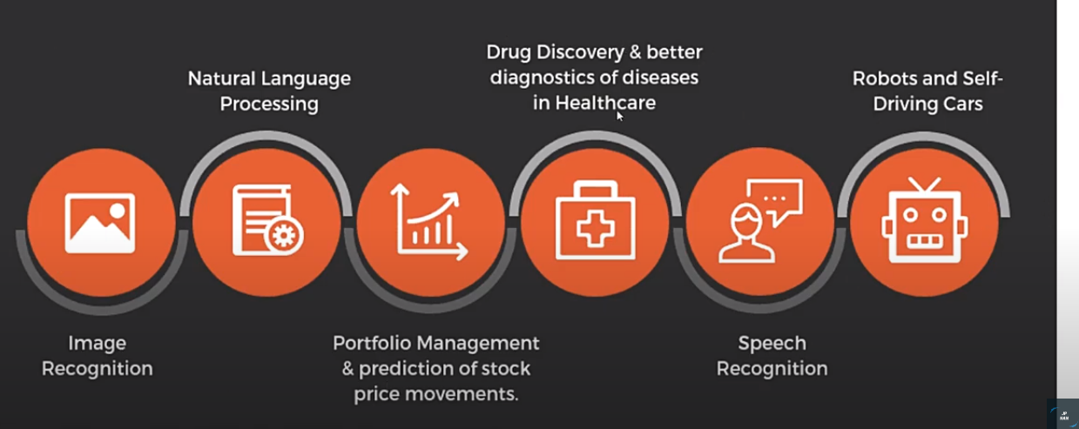

Slide 95
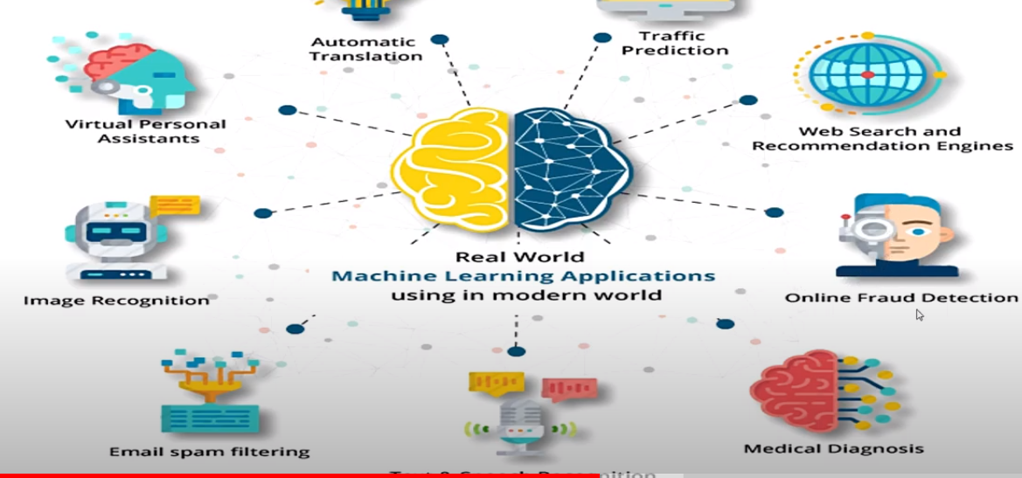
Applications of machine learning and deep learning

Slide 96
Machine learning
Introduction
Basics
Classification
Clustering
Regression
Use-Cases
2

Slide 97
About
subfield of Artificial Intelligence (AI)
name is derived from the concept that it deals with
“construction and study of systems that can learn from data”
can be seen as building blocks to make computers learn to behave more intelligently
It is a theoretical concept. There are various techniques with various implementations.
http://en.wikipedia.org/wiki/Machine_learning

Slide 98
In other words…
“A computer program is said to learn from experience (E) with some class of tasks (T) and a performance measure (P) if its performance at tasks in T as measured by P improves with E”

Slide 99
Terminology
Features
The number of features or distinct traits that can be used to describe
each item in a quantitative manner.
Samples
A sample is an item to process (e.g. classify). It can be a document, a picture, a sound, a video, a row in database or CSV file, or whatever you can describe with a fixed set of quantitative traits.
Feature vector
is an n-dimensional vector of numerical features that represent some
object.
Feature extraction
Preparation of feature vector
transforms the data in the high-dimensional space to a space of
fewer dimensions.
Training/Evolution set
Set of data to discover potentially predictive relationships.

Slide 100
Let’s dig deep into it…
What do you mean by
Apple

Slide 101
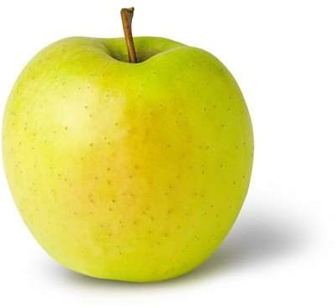
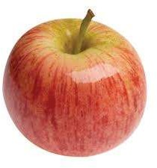

Learning (Training)
Features:
Color: Radish/Red
Type : Fruit
Shape
etc…
Features:
Sky Blue
Logo
Shape
etc…
Features:
Yellow
Fruit
Shape
etc…

Slide 102

Workflow

Slide 103
Categories
Supervised Learning
Unsupervised Learning
Semi-Supervised Learning
Reinforcement Learning

Slide 104

Supervised Learning
the correct classes of the training data are known
Credit: http://us.hudson.com/legal/blog/postid/513/predictive-analytics-artificial-intelligence-science-fiction-e-discovery-truth

Slide 105

Unsupervised Learning
the correct classes of the training data are not known
Credit: http://us.hudson.com/legal/blog/postid/513/predictive-analytics-artificial-intelligence-science-fiction-e-discovery-truth

Slide 106

Semi-Supervised Learning
A Mix of Supervised and Unsupervised learning
Credit: http://us.hudson.com/legal/blog/postid/513/predictive-analytics-artificial-intelligence-science-fiction-e-discovery-truth

Slide 107

Reinforcement Learning
allows the machine or software agent to learn its behavior based on feedback from the environment.
This behavior can be learnt once and for all, or keep on adapting as time goes by.
Credit: http://us.hudson.com/legal/blog/postid/513/predictive-analytics-artificial-intelligence-science-fiction-e-discovery-truth

Slide 108
Machine Learning Techniques

Slide 109
Techniques
classification: predict class from observations
clustering: group observations into “meaningful” groups
regression (prediction): predict value from observations

Slide 110


Slide 111


Slide 112








Face Recognition
Training examples of a person
Test images

Slide 113
Classification
classify a document into a predefined category.
documents can be text, images
Popular one is Naive Bayes Classifier.
Steps:
Step1 : Train the program (Building a Model) using a training set with a category for e.g. sports, cricket, news,
Classifier will compute probability for each word, the probability that it makes a document belong to each of considered categories
Step2 : Test with a test data set against this Model
http://en.wikipedia.org/wiki/Naive_Bayes_classifier

Slide 114
Clustering
clustering is the task of grouping a set of objects in such a way that objects in the same group (called a cluster) are more similar to each other
objects are not predefined
For e.g. these keywords
“man’s shoe”
“women’s shoe”
“women’s t-shirt”
“man’s t-shirt”
can be cluster into 2 categories “shoe” and “t-shirt” or “man” and “women”
Popular ones are K-means clustering and Hierarchical clustering

Slide 115

K-means Clustering
partition n observations into k clusters in which each observation belongs to the cluster with the nearest mean, serving as a prototype of the cluster.
http://en.wikipedia.org/wiki/K-means_clustering
http://pypr.sourceforge.net/kmeans.html

Slide 116
Hierarchical clustering
method of cluster analysis which seeks to build a hierarchy of clusters.
There can be two strategies
Agglomerative:
This is a "bottom up" approach: each observation starts in its own cluster, and pairs of clusters are merged as one moves up the hierarchy.
Time complexity is O(n^3)
Divisive:
This is a "top down" approach: all observations start in one cluster, and splits are performed recursively as one moves down the hierarchy.
Time complexity is O(2^n)
http://en.wikipedia.org/wiki/Hierarchical_clustering

Slide 117

Regression
is a measure of the relation between the mean value of one variable (e.g. output) and corresponding values of other variables (e.g. time and cost).
regression analysis is a statistical process for estimating the relationships among variables.
Regression means to predict the output value using training data.
Popular one is Logistic regression (binary regression)
http://en.wikipedia.org/wiki/Logistic_regression

Slide 118
Regression vs Classification
Regression means to predict the output value using training data.
regression to predict the house price from training data
if it is a real number/continuous, then it is regression problem.
Classification means to group the output into a class.
classification to predict the type of tumor i.e. harmful or not harmful using training data
if it is discrete/categorical variable, then it is classification problem

Slide 119
Let’s see the usage in Real life

Slide 120
Use-Cases
Spam Email Detection
Machine Translation (Language Translation)
Image Search (Similarity)
Clustering (KMeans) : Amazon Recommendations
Classification : Google News
continued…

Slide 121
Use-Cases (contd.)
Text Summarization - Google News
Rating a Review/Comment: Yelp
Fraud detection : Credit card Providers
Decision Making : e.g. Bank/Insurance sector
Sentiment Analysis
Speech Understanding – iPhone with Siri
Face Detection – Facebook’s Photo tagging

Slide 122
Popular Frameworks/Tools
Weka
Carrot2
Gate
OpenNLP
LingPipe
Stanford NLP
Mallet – Topic Modelling
Gensim – Topic Modelling (Python)
Apache Mahout
MLib – Apache Spark
scikit-learn - Python
LIBSVM : Support Vector Machines
and many more…

Slide 123
Advanced concepts (related to IR)
Topic Modelling
Latent Dirichlet allocation (LDA)
Latent semantic analysis (LSA/LSI) - Semantic Search
Singular Value Decomposition (SVD)
Summarization (without Training)

Slide 124
THANK YOU
Soft Computing Applications

